Slide 1
Final Engagement
Attack, Defense & Analysis of a Vulnerable Network

Slide 2
Table of Contents
This document contains the following resources:
Network Topology & Critical Vulnerabilities
Traffic Profile
Normal Activity
Malicious Activity

Slide 3
Network Topology
& Critical Vulnerabilities
‹#›

Slide 4
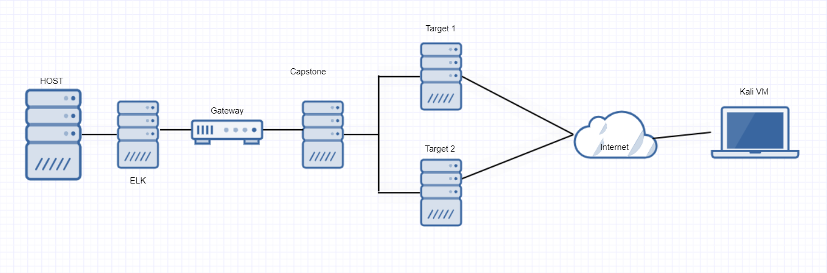
Network Topology
Network
Address Range: 192.168.1.0/24
Netmask: 255.255.255.0
Gateway: 192.168.1.1
Machines
IPv4: 192.168.1.100
OS: Ubuntu
Hostname: ELK
IPv4: 192.168.1.105
OS: Linux
Hostname: Capstone
IPv4: 192.168.1.110
OS: Linux
Hostname: Target 1
IPv4: 192.168.1.115
OS: Linux
Hostname: Target 2

Slide 5
Critical Vulnerabilities: Target 1
Our assessment uncovered the following critical vulnerabilities in Target 1.
Vulnerability | Description | Impact
Wordpress User Enum | WP exposes users via WPScan | Allows user accounts to be brute forced
MySQL Creds | SQL database credentials were stored in cleartext in the wp-config file. | Allows an attacker to view all SQL databases and tables.
sudo python | User steven is able to run python as root | Allows an attacker to spawn a root shell via python.
Crackable Passwords | Able to use john the ripper on password hashes | Allows attacker to obtain user password.

Slide 6
Critical Vulnerabilities: Target 2
Our assessment uncovered the following critical vulnerabilities in Target 2.
Vulnerability | Description | Impact
PHPMailer XSS (CVE-2016-10033) | Allows an attacker RCE. | Able to spawn a reverse shell via XSS.
MySQL Default Credentials | wp-config file revealed root SQL password. | Able to gain root MySQL access.
mysql binary is run as root | The mysql binary has root-level permissions. | Attackers are able to craft a SQL function to execute code as root.
General access to website directories. | No restricted access to directories allowed for discovery of sensitive information. | Able to perform Directory Traversal.

Slide 7
Traffic Profile
‹#›

Slide 8
Traffic Profile
Our analysis identified the following characteristics of the traffic on the network:
Feature | Value | Description
Top Talkers (IP Addresses) | 172.16.4.205 | Machines that sent the most traffic.
Most Common Protocols | TCP, HTTP, UDP | Three most common protocols on the network.
# of Unique IP Addresses | 810 | Count of observed IP addresses.
Subnets | 10.6.12.0/24 172.16.4.0/24 10.0.0.0/24 | Observed subnet ranges.
# of Malware Species | 1 | Number of malware binaries identified in traffic.
Notes:
You may have more than 2 subnets.

Slide 9
Behavioral Analysis
Purpose of Traffic on the Network
Users were observed engaging in the following kinds of activity.
“Normal” Activity
Visiting websites
Authenticating with Kerberos
Suspicious Activity
Downloading malware and torrents.

Slide 10
Normal Activity
‹#›

Slide 11
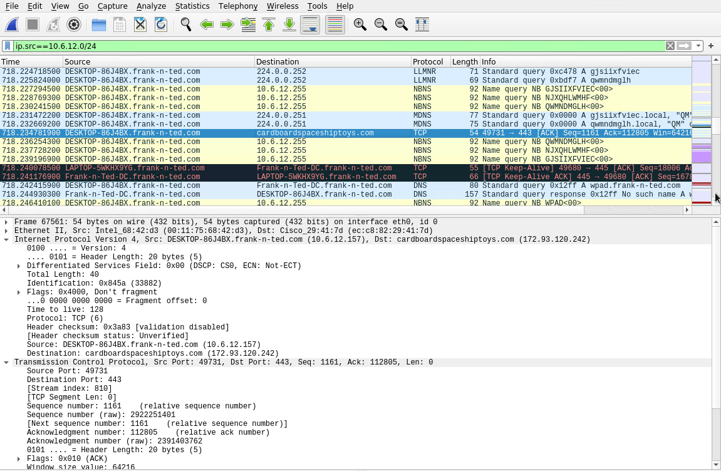
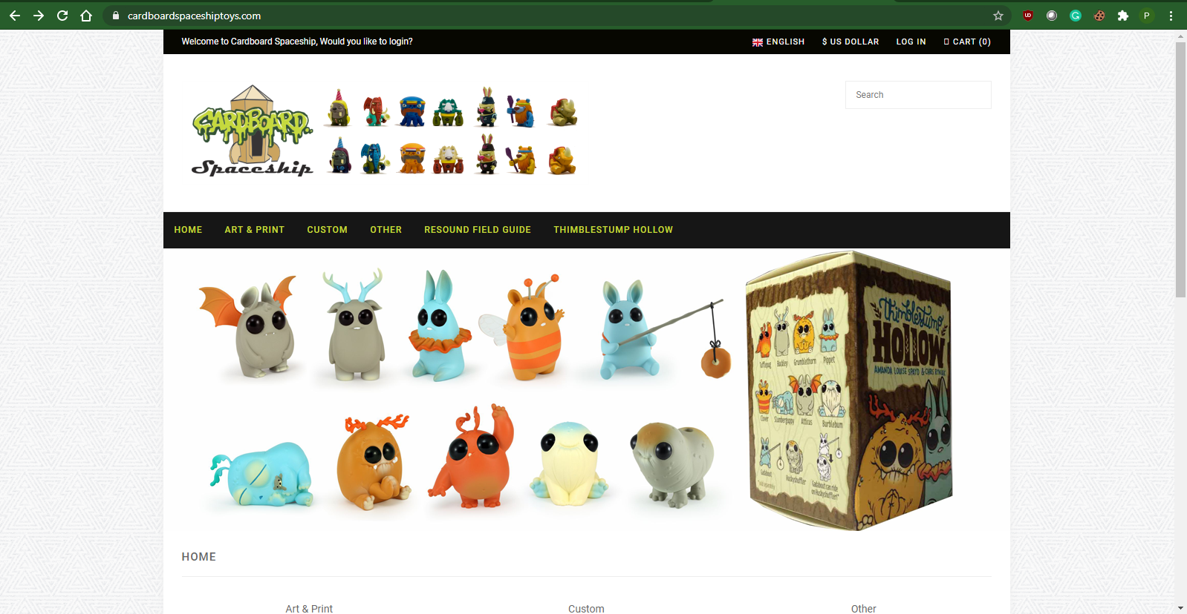
Visiting cardboardspaceshiptoys.com for reasons unknown
Summarize the following:
What kind of traffic did you observe? Which protocol(s)?
TCP, LDAP, DHCP, DNS
What, specifically, was the user doing? Which site were they browsing? Etc.
User visited cardboardspaceshiptoys.com
Include screenshots of packets justifying your conclusions.

Slide 12
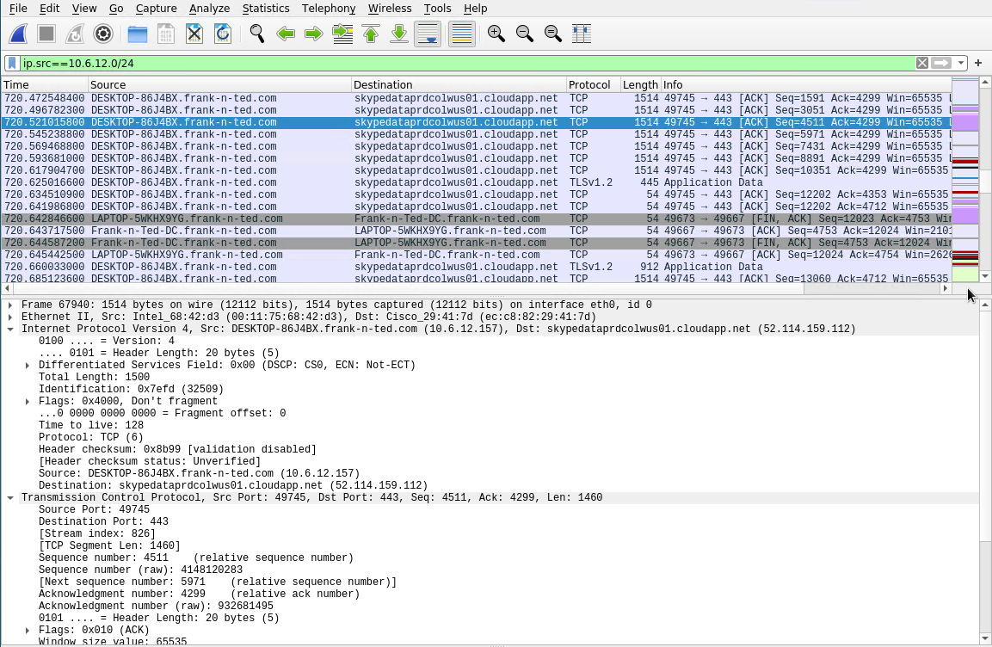
SKYPE
Summarize the following:
What kind of traffic did you observe? Which protocol(s)?
TCP
What, specifically, was the user doing? Which site were they browsing? Etc.
User used communication software known as skype.
Include screenshots of packets justifying your conclusions.

Slide 13
Malicious Activity
‹#›

Slide 14
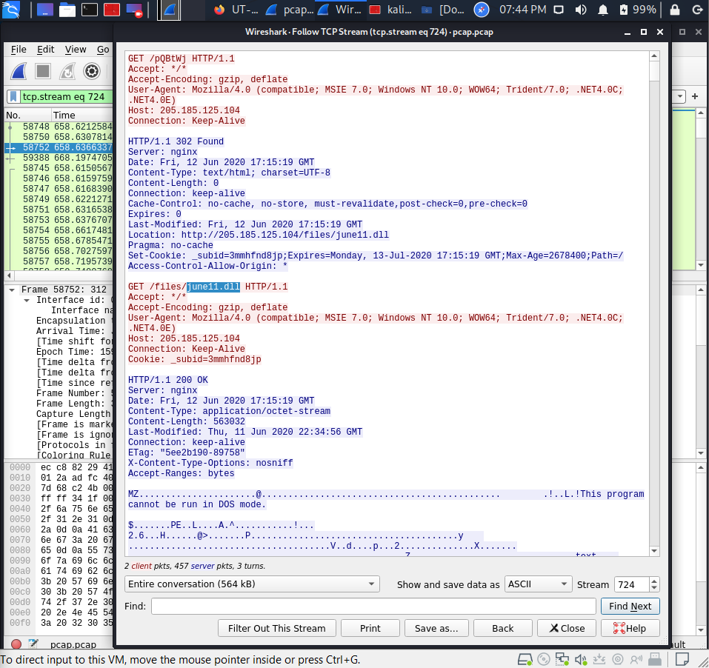
Malware Download
Summarize the following:
What kind of traffic did you observe?
HTTP
What, specifically, was the user doing? Which site were they browsing?
User downloaded june11.dll from frank-n-ted.com
Include screenshots of packets justifying your conclusions.
Include a description of any interesting files.
june11.dll is a trojan malware designed to infect the inflicted machine.

Slide 15
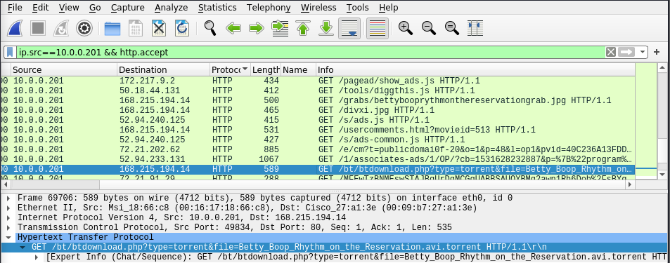
Torrent Download
Summarize the following:
What kind of traffic did you observe? Which protocol(s)?
HTTP
What, specifically, was the user doing? Which site were they browsing? Etc.
User downloaded a torrent (/bt/btdownload.php?type=torrent&file=Betty_Boop_Rhythm_on_the_Reservation.avi.torrent)
Include screenshots of packets justifying your conclusions.
Include a description of any interesting files.
Though the torrent might be a simple video,
there is a high possibility that there is other
malware attached to the file that can
negatively impact the host machine’s
functionality.

Slide 16
The End
‹#›

